Slide 1
Feasibility Report
Using the Yardstick Approach

Slide 2
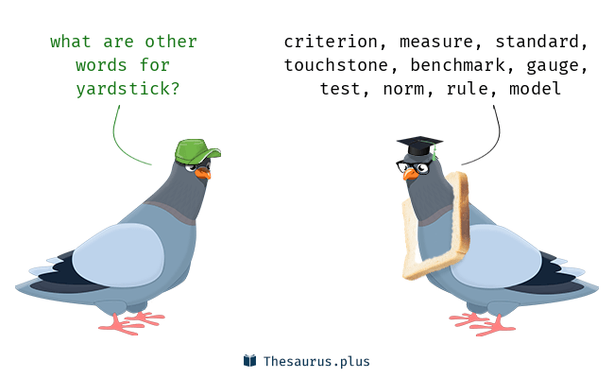

Slide 3
The Yardstick Approach
The way to measure several solutions to a single problem
Evaluating each solution against a criteria
Finding the best solution for a particular problem that fulfills the criteria
Finally, choosing one solution that is recommended based upon the facts and how it best fits into the criteria.

Slide 4

How to use the YSA
Look at multiple solutions to a problem
Defines the criteria with which a solution is chosen over others
Each possible solution is explained and finally a recommendation is made, for the best solution, according to the criteria

Slide 5
Step 1: Identify the problem
Clearly state the problem at hand
For example: A new product has been developed that needs to be launched in the target market. The company must run an appropriate advertising campaign for the new product so the masses are introduced to it, are attracted to it, and the sale increases as a result of the advertisement campaign.

Slide 6
Step 2: List all possible solutions to the problem
The company trying to choose appropriate advertising for a new product can choose to advertise through various available mediums.
For example,
Advertise through,
Television ads
Print ads in the newspaper
Internet advertisements
Radio advertisements
Billboard advertisements

Slide 7
Step 3: Define criteria by which to choose a solution
Include or exclude aspects of a solution
The criteria must be specific enough to narrow down the solutions.
For example,
The criteria for choosing an advertising method might include,
Limited funds
Broad appeal
A desire to direct people to a website where they are able to purchase the specified product.

Slide 8
Step 4: Compare each solution to the criteria
Analyze each option thoroughly and clearly
For example,
Television advertising would be expensive, but targets a wide range of people.
Newspaper ads would target only a specific region of people, but would cost less.
Internet ads would target a wide range of people and the budget can be adjusted as needed. Internet ads can also send people directly to website.
Radio ads can reach a wide variety of people, but only in a specific geographic area and can cost a good deal of money.
Billboard ads can be made cheaply with small roadside signs, but the size is limited and people driving by may not remember the web address.

Slide 9
Step 4: Decide on a solution
Make a recommendation.
Recommendation must be based on facts
For example,
Internet advertising makes the most sense, as it fulfills all the criteria.

